Slide 1
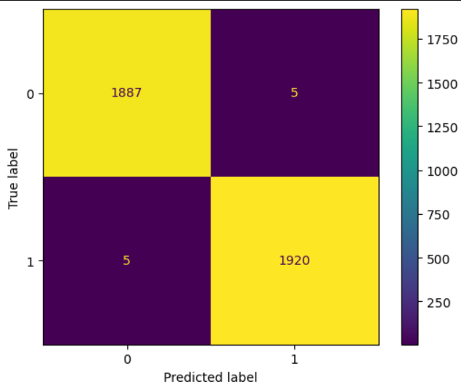
TikTok Claims Classification Project
The Final Product
We seek to develop a machine learning model to assist in the classification of videos as either claims or opinions. Previous investigation into the available data revealed that video engagement levels were highly indicative of claim status. The team is confident that the resulting model will meet all performance requirements.
TikTok videos receive a large number of user reports for many different reasons. Not all reported videos can undergo review by a human moderator. Videos that make claims (as opposed to opinions) are much more likely to contain content that violates the platform’s terms of service. TikTok seeks a way to identify videos that make claims to prioritize them for review.
We built two tree-based classification models. Both models were used to predict on a held-out validation dataset, and final model selection was determined by the model with the best recall score. The final model was then used to score a test dataset to estimate future performance.
Both model architectures—random forest (RF) and XGBoost—performed exceptionally well. The RF model had a better recall score (0.995) and was selected as champion.
Performance on the test holdout data yielded near perfect scores, with only five misclassified samples out of 3,817.
Subsequent analysis indicated that, as expected, the primary predictors were all related to video engagement levels, with video view count, like count, share count, and download count accounting for nearly all predictive signal in the data. With these results, we can conclude that videos with higher user engagement levels were much more likely to be claims. In fact, no opinion video had more than 10,000 views.
Image Alt-Text Here
As noted, the model performed exceptionally well on the test holdout data. Before deploying the model, we recommend further evaluation using additional subsets of user data. Furthermore, we recommend monitoring the distributions of video engagement levels to ensure that the model remains robust to fluctuations in its most predictive features.

